Slide 1
Too much of a good thing?
Pink Salmon abundance in the Indian River
Brian McGreal

Slide 2
Hyperabundance of endemic species

Slide 3
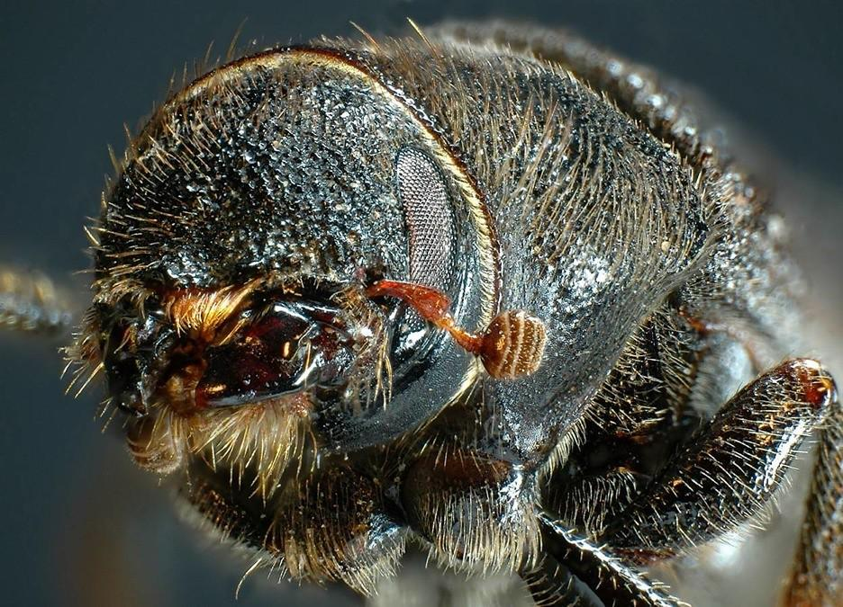

Hyperabundance of endemic species
Mountain pine beetle
Sea urchins
Credit: Simon Fraser University, Oregon State University

Slide 4
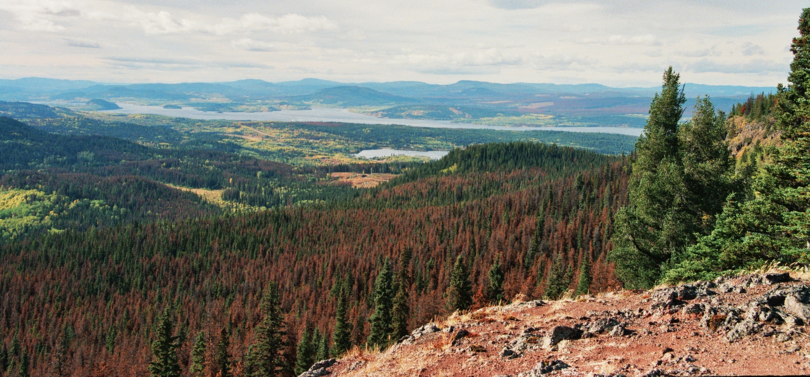

Hyperabundance of Endemic Species
Mountain Pine Beetle
Credit: Themightyquill

Slide 5
Hyperabundance of Endemic Species
Mountain Pine Beetle
Credit: Themightyquill

Slide 6
Hyperabundance of Endemic Species
Mountain Pine Beetle
- Endemic to western US and Canada
Credit: Themightyquill

Slide 7
Hyperabundance of Endemic Species
Mountain Pine Beetle
- Endemic to western US and Canada
- Life cycle destroys coniferous trees
Credit: Themightyquill

Slide 8
Hyperabundance of Endemic Species
Mountain Pine Beetle
- Endemic to western US and Canada
- Life cycle destroys coniferous trees
- Shifting climate leads to frequent outbreaks
Credit: Themightyquill

Slide 9
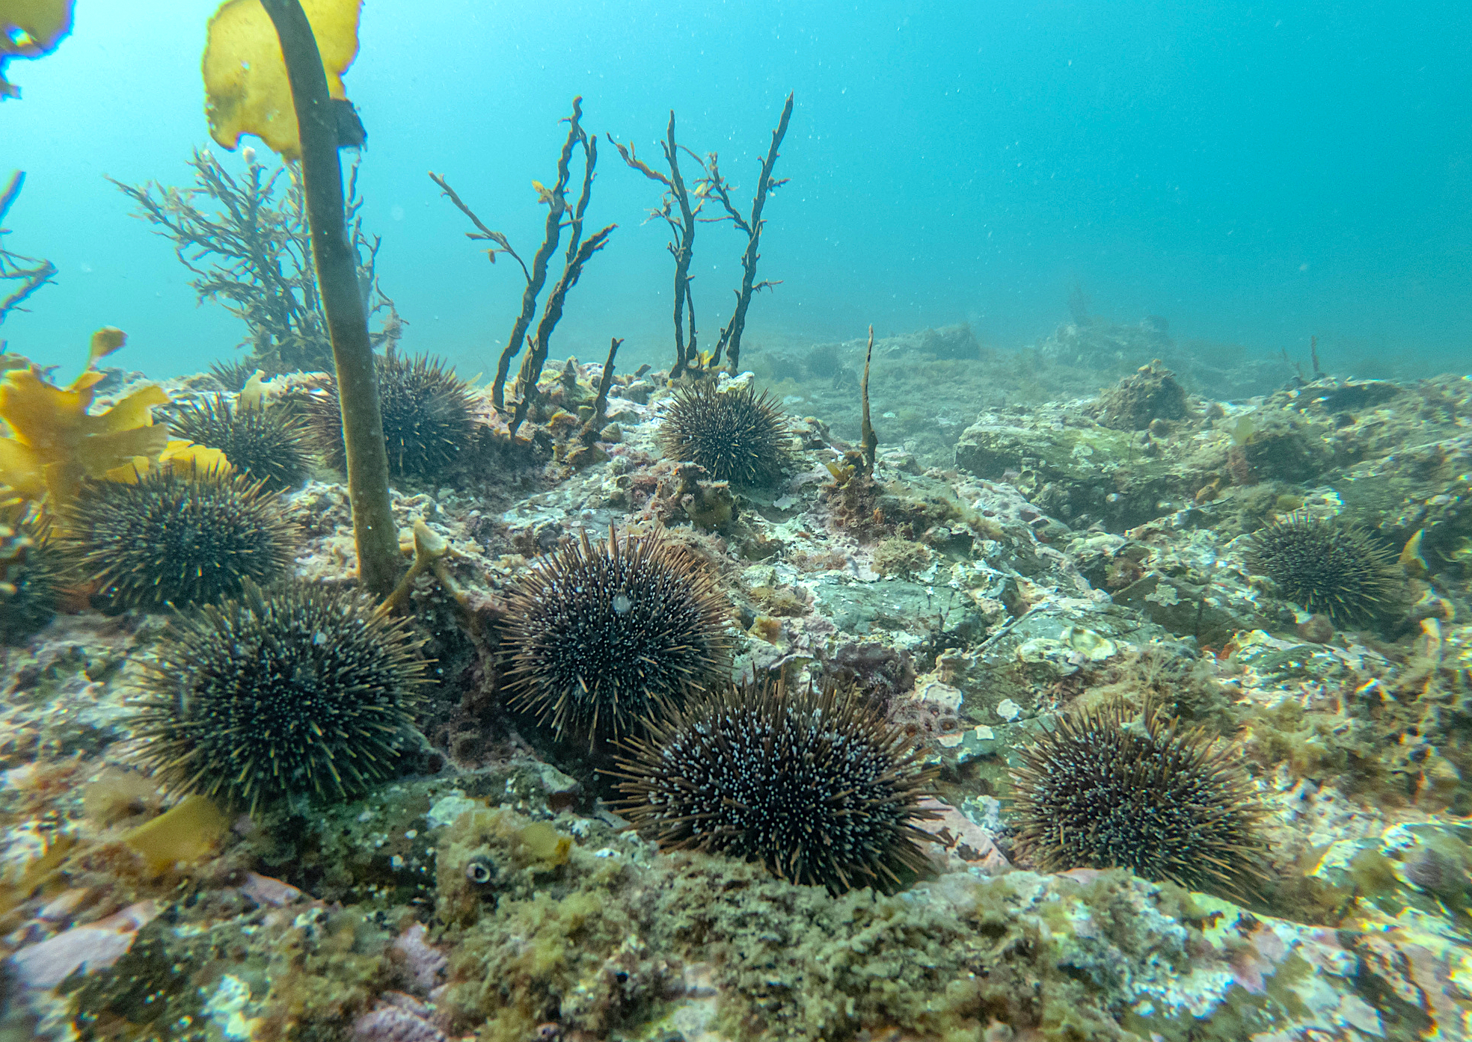
Hyperabundance of Endemic Species
Sea Urchins
Credit: Shaun Lee

Slide 10
Hyperabundance of Endemic Species
Sea Urchins
Credit: Shaun Lee

Slide 11
Hyperabundance of Endemic Species
Sea Urchins
- Pacific coast of US and Canada
Credit: Shaun Lee

Slide 12
Hyperabundance of Endemic Species
Sea Urchins
- Pacific coast of US and Canada
- Feed on kelp
Credit: Shaun Lee

Slide 13
Hyperabundance of Endemic Species
Sea Urchins
- Pacific coast of US and Canada
- Feed on kelp
- Decimated otter populations have reduced natural predation
Credit: Shaun Lee

Slide 14
Hyperabundance of endemic species
Indirect human action
(climate change)
Direct human action
(otter hunting)

Slide 15
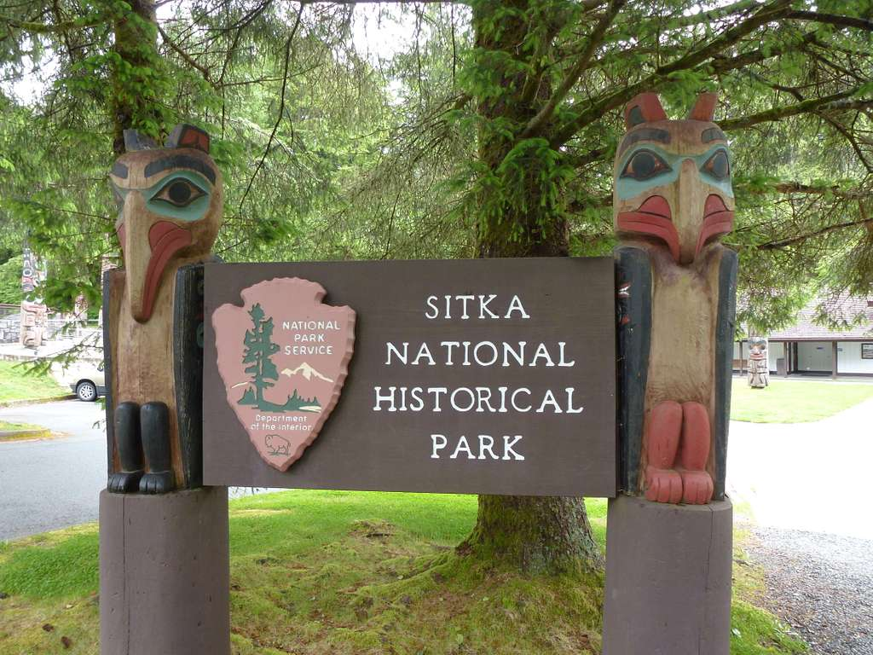
Credit: John Bromley

Slide 16
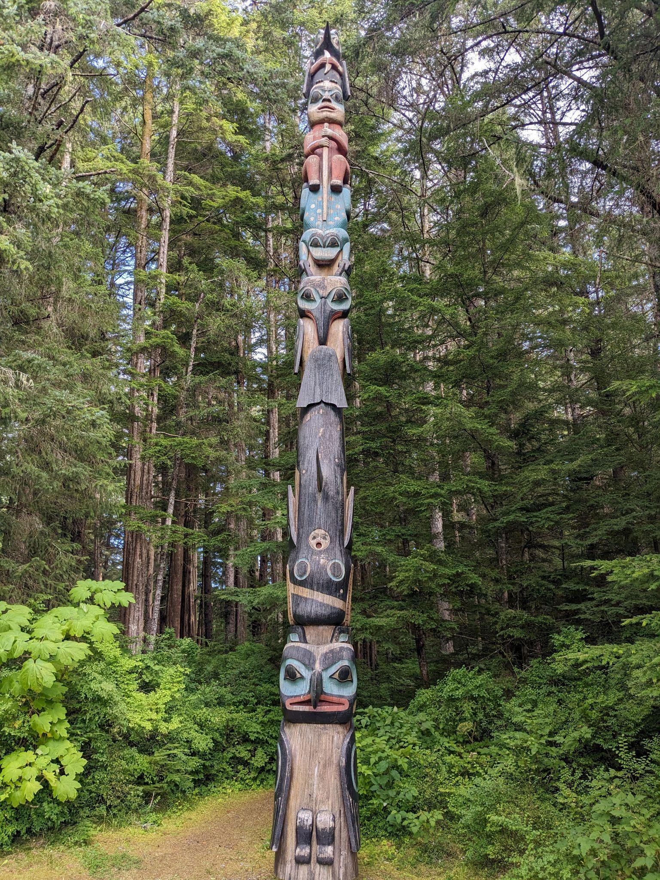
Sitka National Historical Park – History

Slide 17
Sitka National Historical Park – History
- Ancestral home of Kiks.ádi clan (Sitka Tribe of Alaska)

Slide 18
Sitka National Historical Park – History
- Ancestral home of Kiks.ádi clan (Sitka Tribe of Alaska)
- Site of pivotal 1802 & 1804 battles with Russian colonizers

Slide 19
Sitka National Historical Park – History
- Ancestral home of Kiks.ádi clan (Sitka Tribe of Alaska)
- Site of pivotal 1802 & 1804 battles with Russian colonizers
- Declared a National Monument in 1910
Notes:
Due to the history, and numerous totem poles (none of which were local in origin)

Slide 20
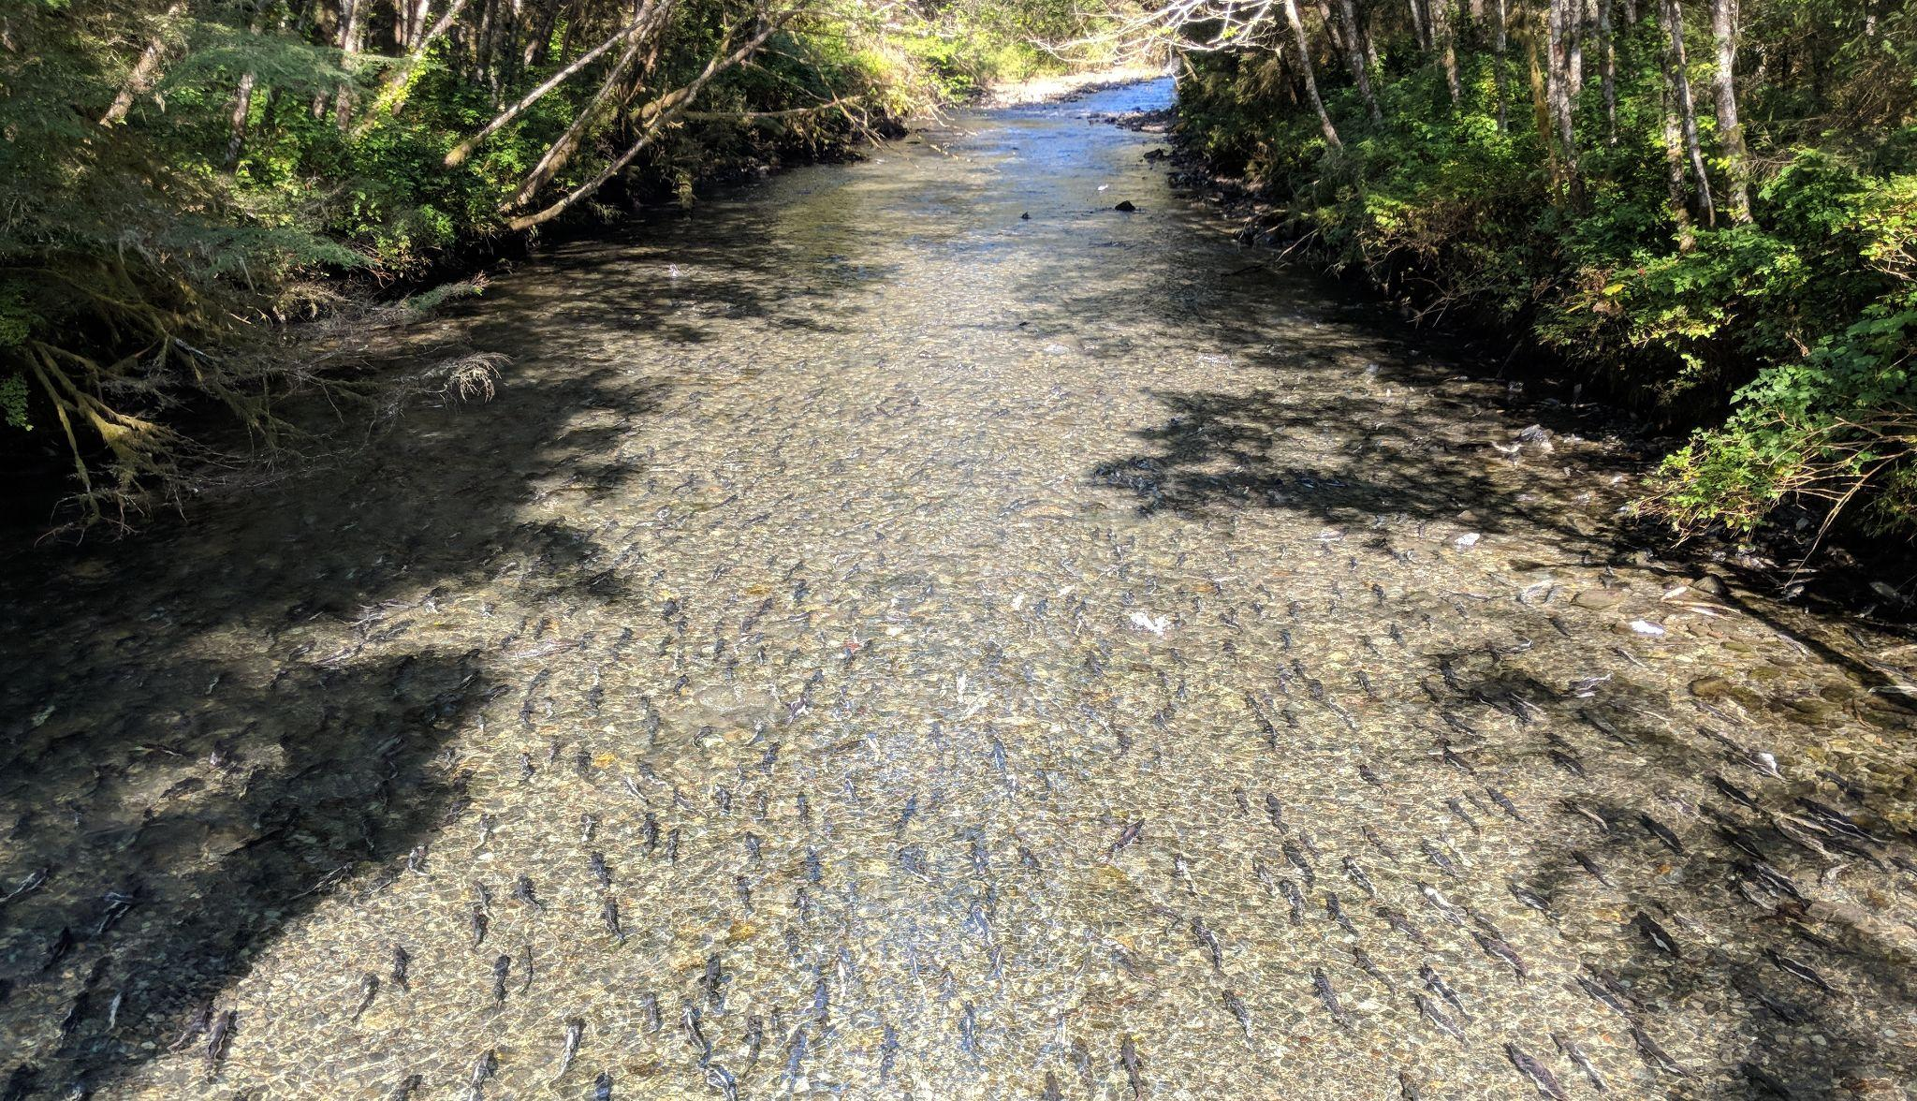
Sitka National Historical Park – Indian River
Notes:
a.k.a. Kaasda Héen
Predominant natural feature
Supports chum and coho runs
Home to rainbow trout, Dolly Varden, cutthroat trout, stickleback, sculpin
Supports large pink salmon runs

Slide 21
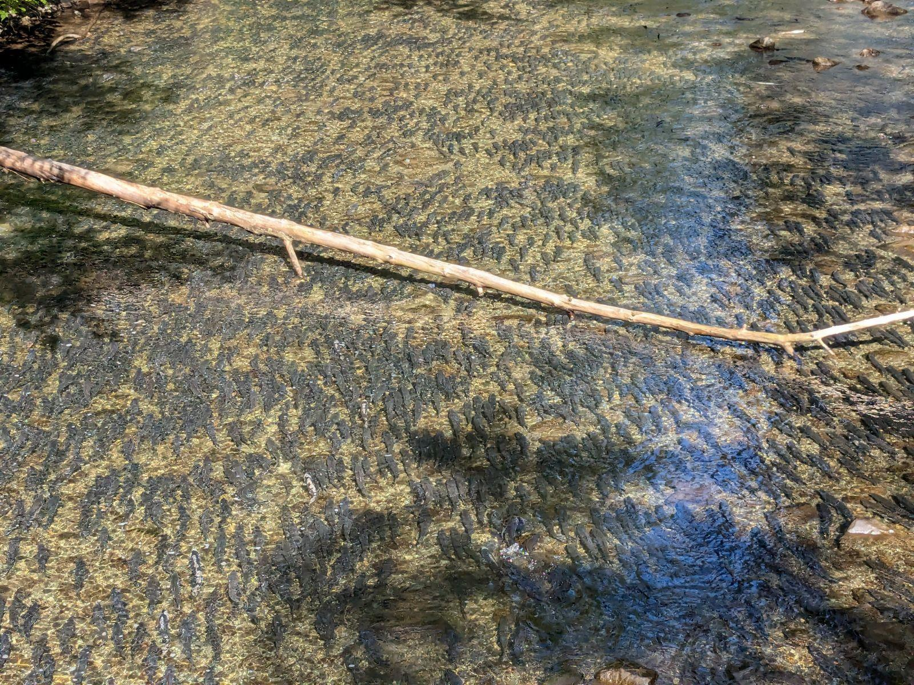
Sitka National Historical Park – Pink Salmon

Slide 22
Sitka National Historical Park – Pink Salmon
Notes:
a.k.a. Kaasda Héen
Predominant natural feature
Supports large pink salmon runs
Home to rainbow trout, Dolly Varden, cut

Slide 23
Sitka National Historical Park – Pink Salmon
- Kiks.ádi fishing camp established in the ancient past
Notes:
a.k.a. Kaasda Héen
Predominant natural feature
Supports large pink salmon runs
Home to rainbow trout, Dolly Varden, cut

Slide 24
Sitka National Historical Park – Pink Salmon
- Kiks.ádi fishing camp established in the ancient past
- Strong pink salmon runs into 20th century
Notes:
a.k.a. Kaasda Héen
Predominant natural feature
Supports large pink salmon runs
Home to rainbow trout, Dolly Varden, cut

Slide 25
Sitka National Historical Park – Pink Salmon
- Kiks.ádi fishing camp established in the ancient past
- Strong pink salmon runs into 20th century
“…it seemed like you should just be able to walk across the river on the humpies, there were so many of them.” –Isabella Brady, Tlingit elder
Notes:
a.k.a. Kaasda Héen
Predominant natural feature
Supports large pink salmon runs
Home to rainbow trout, Dolly Varden, cut

Slide 26
Sitka National Historical Park – Pink Salmon
- Kiks.ádi fishing camp established in the ancient past
- Strong pink salmon runs into 20th century”
“…it seemed like you should just be able to walk across the river on the humpies, there were so many of them.” –Isabella Brady, Tlingit elder
- Gravel removal in 1939 decimated salmon runs
Notes:
a.k.a. Kaasda Héen
Predominant natural feature
Supports large pink salmon runs
Home to rainbow trout, Dolly Varden, cut

Slide 27
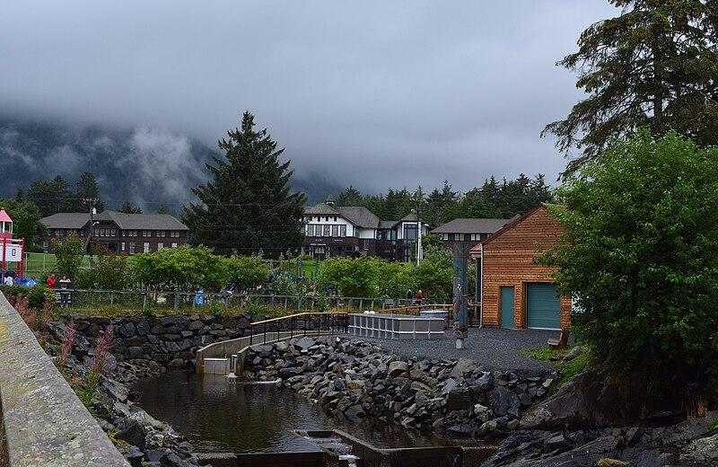
Sitka National Historical Park – Sheldon Jackson Hatchery
Credit: Joe Mabel

Slide 28
Sitka National Historical Park – Sheldon Jackson Hatchery
- Releases 3 million pink salmon per year

Slide 29
Sitka National Historical Park – Sheldon Jackson Hatchery
- Releases 3 million pink salmon per year
- Aided recovery of pink salmon run in 1970s

Slide 30
Sitka National Historical Park – Sheldon Jackson Hatchery
- Releases 3 million pink salmon per year
- Aided recovery of pink salmon run in 1970s
- Draws water from Indian River

Slide 31
Sitka National Historical Park – Sheldon Jackson Hatchery
- Releases 3 million pink salmon per year
- Aided recovery of pink salmon run in 1970s
- Draws water from Indian River
- Broodstock from Indian River and Starrigavin Creek

Slide 32
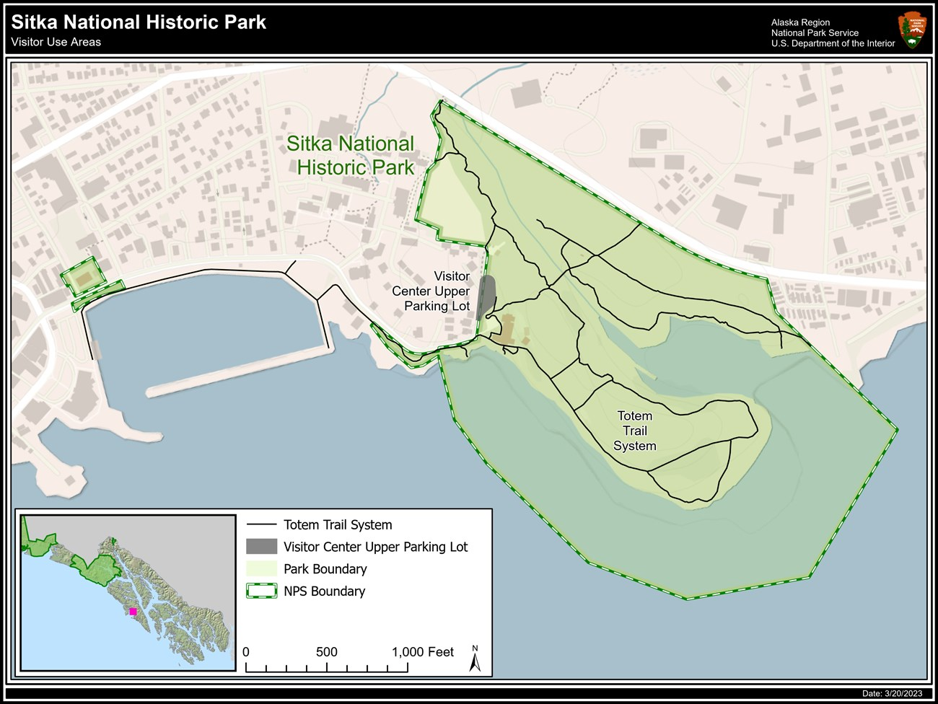
Sitka National Historical Park
Sheldon Jackson Hatchery
Credit: National Park Service

Slide 33

Sitka National Historical Park
Sheldon Jackson Hatchery

Slide 34
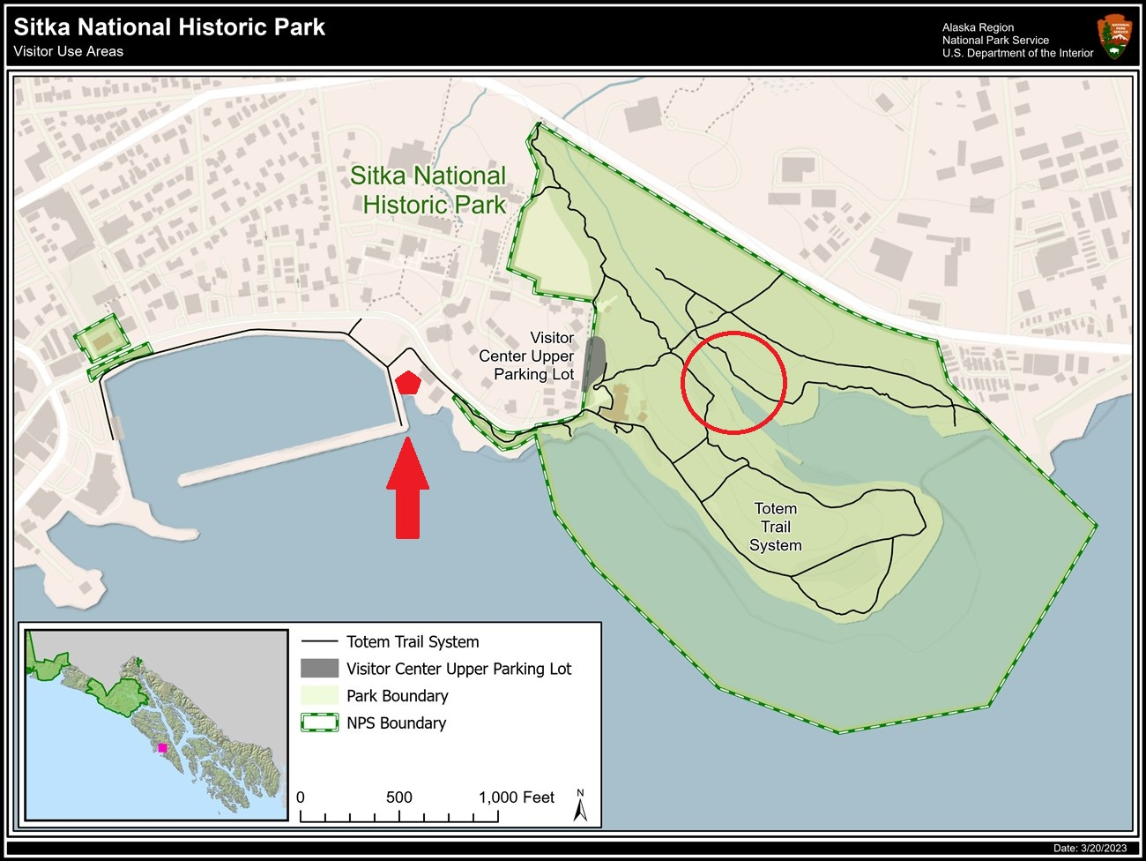
Sitka National Historical Park
Sheldon Jackson Hatchery
Notes:
Approx. 1,600 feet from hatchery to river mouth

Slide 35
Hyperabundance?
Notes:
a.k.a. Kaasda Héen
Predominant natural feature
Supports large pink salmon runs
Home to rainbow trout, Dolly Varden, cut

Slide 36
Hyperabundance?

Slide 37
Hyperabundance?
- Decomposition of pink salmon depletes dissolved oxygen in stream

Slide 38
Hyperabundance?
- Decomposition of pink salmon depletes dissolved oxygen in stream
- Flows typically low during late summer salmon run

Slide 39
Hyperabundance?
- Decomposition of pink salmon depletes dissolved oxygen in stream
- Flows typically low during late summer salmon run
- Potentially fatal events for other resident species

Slide 40
National Parks and conservation
“[The National Park Service] shall promote and regulate the use of Federal areas known as national parks… which purpose is to conserve the scenery and the natural and historic objects and the wildlife therein and to provide for the enjoyment of the same in such manner and by such means as will leave them unimpaired for the enjoyment of future generations”
–NPS Organic Act of 1916

Slide 41
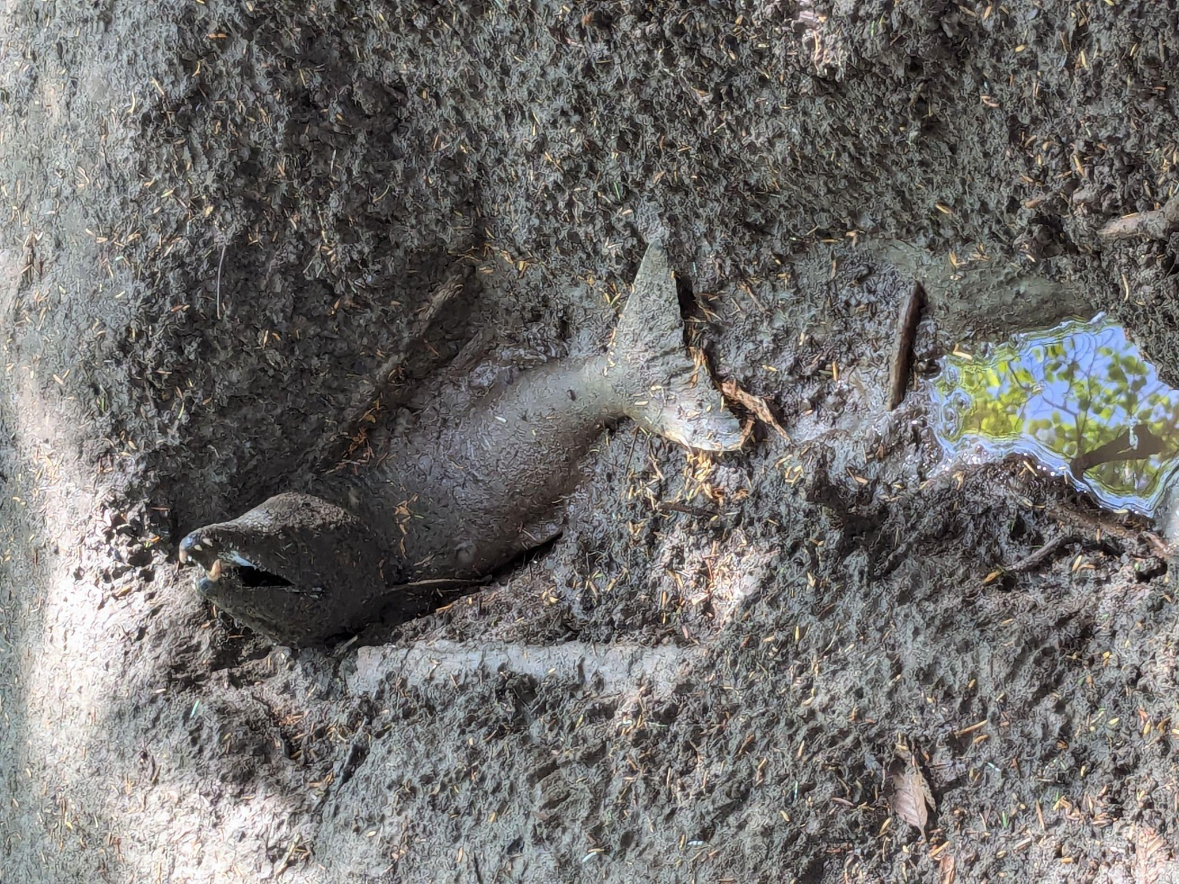
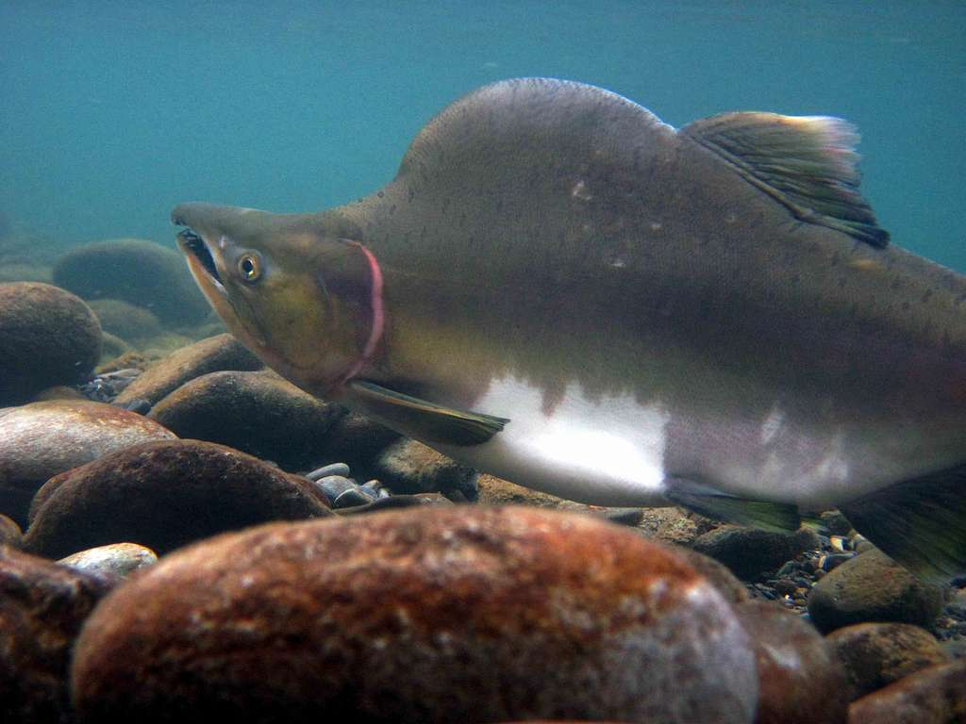
Pink Salmon in Southeast Alaska
Credit: National Parks Gallery

Slide 42
Pink Salmon in Southeast Alaska
- Very abundant, most numerous salmon species in the region

Slide 43
Pink Salmon in Southeast Alaska
- Very abundant, most numerous salmon species in the region
- High rates of straying relative to other salmon species

Slide 44

Hyperabundance of pink salmon
Indirect human action
(climate shifts)
Direct human action
(hatchery operations)

Slide 45
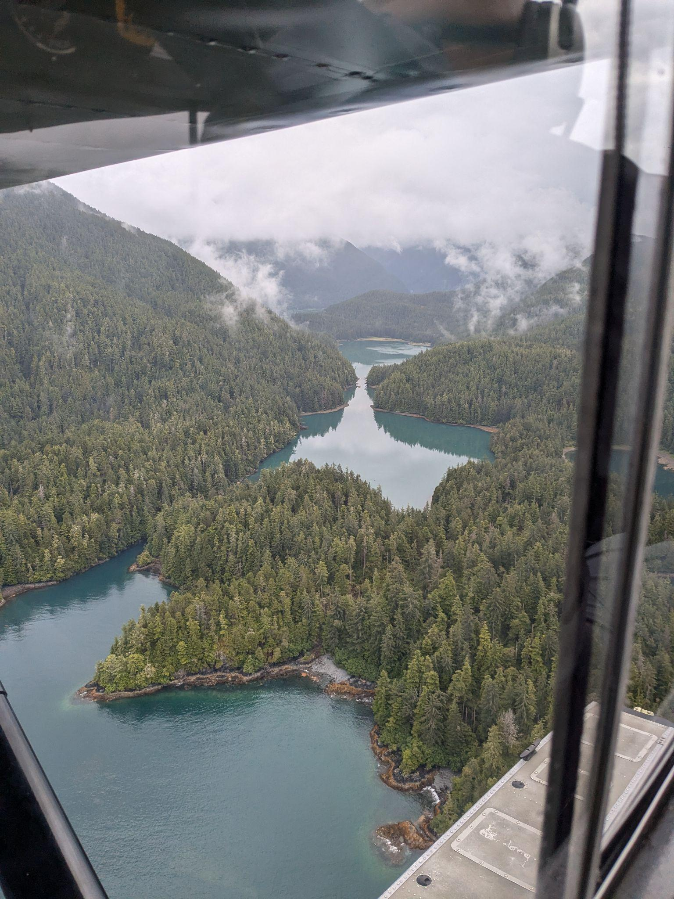
Where does the data come from?
Alaska Dept of Fish Game
Fixed wing aircraft survey
714 pink salmon index streams in SE Alaska
Assessing escapement in order to regulate fishery
- Data validated by random foot counts
Credit: Aaron DuPuis

Slide 46
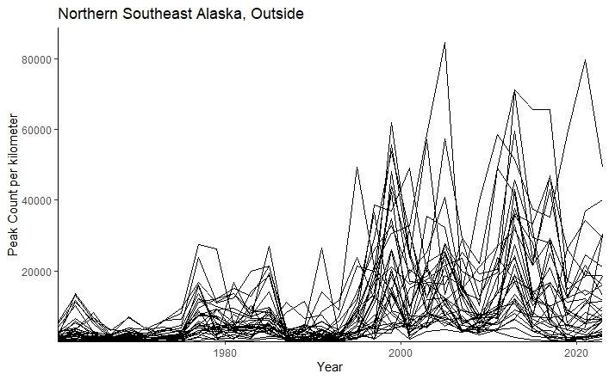
Pink Salmon in Southeast Alaska

Slide 47
Where does the Indian River fit in this picture?

Slide 48
Where does the Indian River fit in this picture?
H0: Sheldon Jackson Hatchery pink salmon releases do not contribute to the abundance of pink salmon in the Indian River

Slide 49
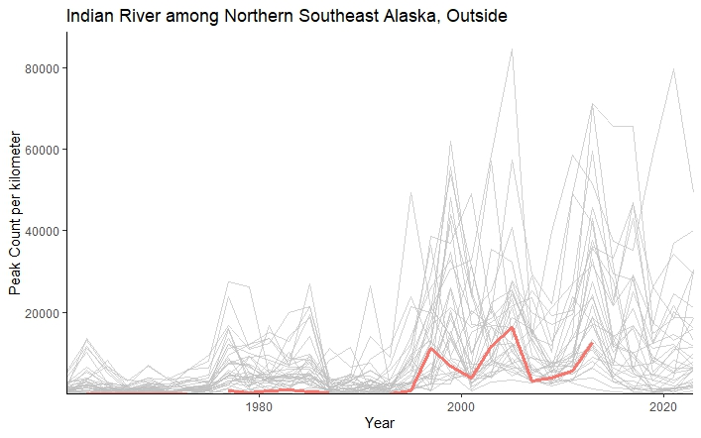
Where does the Indian River fit in this picture?

Slide 50
Where does the Indian River fit in this picture?
State-space model allows for: - Estimates of underlying state (xt) based on what is observed (yt) - Estimates of year-to-year variance in underlying state (xt) - Gaps in the observed time series (yt), as seen at in Indian River

Slide 51
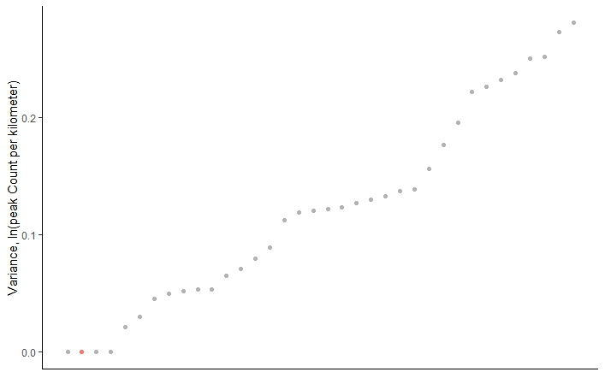
Where does the Indian River fit in this picture?
Year-to-year variance

Slide 52
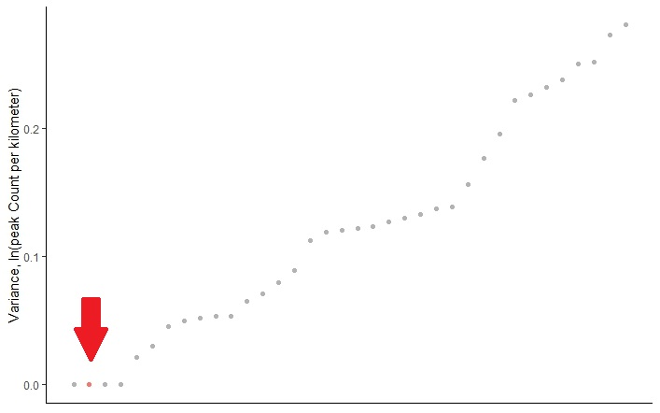
Where does the Indian River fit in this picture?
Year-to-year variance
Notes:
Low variance but still comparable to natural index streams

Slide 53
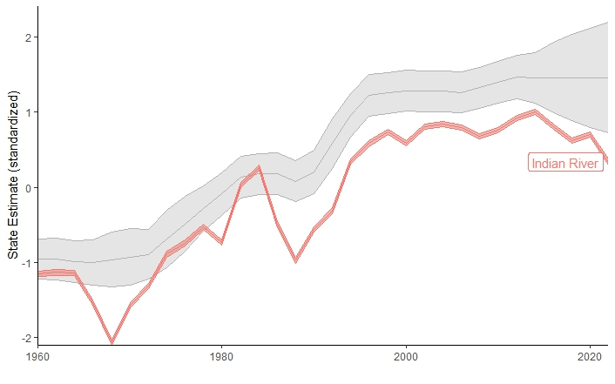
Where does the Indian River fit in this picture?
States – Indian River v. other index streams

Slide 54
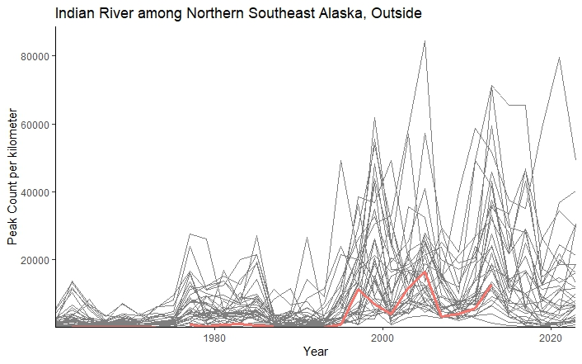
Where does the Indian River fit in this picture?
So far, nothing about this system seems out of line with the broader region…

Slide 55
Implications?

Slide 56
Implications
Pink salmon abundance may be due to regional trends

Slide 57
Implications
Pink salmon abundance may be due to regional trends

Slide 58
Implications
Pink salmon abundance may be due to regional trends
Complicated management challenge

Slide 59
Implications
Pink salmon abundance may be due to regional trends
Complicated management challenge
What is a “natural” condition?

Slide 60
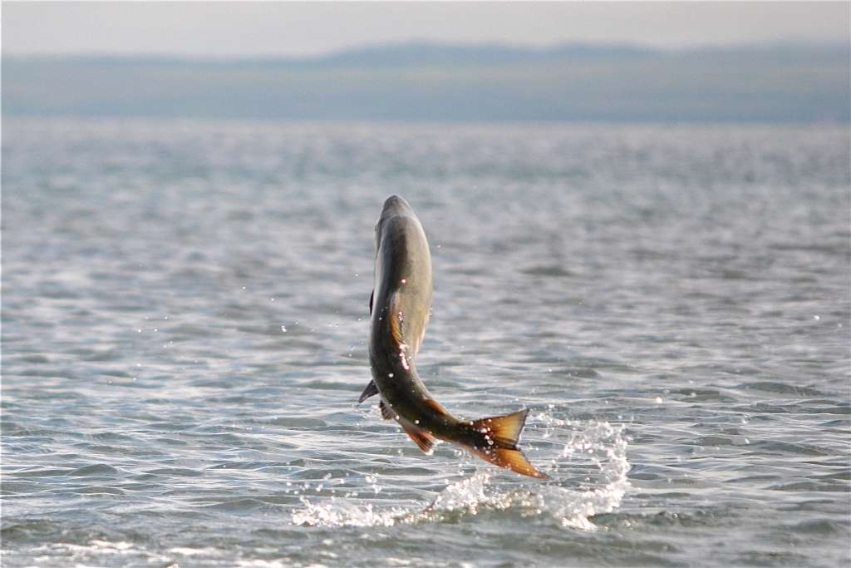
Next steps
Scaling salmon count data by habitat area
Modeling Indian River system directly
Including known stray rates (from and to hatchery)
Incorporating stream level variables
Credit: US Fish and Wildlife Service

Slide 61





Too much of a good thing?
Pink Salmon abundance in the Indian River
Brian McGreal bmcgreal@uw.edu

